Slide 1
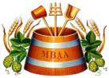
Antimicrobial Control and Silver Ion
The Best System
William Jacoby
PurClean, LLC .
MBAA-Rocky Mountain District
Technical Summit
Friday June 25, 2010

Slide 2
History of Silver as a Purifying Agent
The value of silver in medicine, and as a purifier has been acknowledged for centuries. In ancient Greece and Rome, people used silver containers to keep water, wine and vinegar fresh. When settlers moved across the American West, they would purify a container of water by dropping a silver dollar in it overnight. Towards the end of the 19th century, other medicinal uses for silver were developed including the use of silver and mercury in filling cavities, and the dropping of a silver nitrate solution into the eyes of newborn babies to prevent blindness due to infection.

Slide 3
History of Silver as a Purifying Agent
The value of silver in medicine, and as a purifier has been acknowledged for centuries. In Ancient Greece and Rome, people used silver containers to keep water, and vinegar fresh. When settlers moved across the American West, they would purify a container of water by dropping a silver dollar in it overnight. Towards the end of the 19th century, other medicinal uses for silver were developed including the use of silver and mercury in filling cavities, and the dropping of a silver nitrate solution into the eyes of newborn babies to prevent blindness due to infection.
After testing 23 methods of purifying water, NASA has also chosen silver as the purifying agent on the Space Shuttle program. Silver was used to provide shuttle crews with pure water for drinking, air conditioning, food preparation and other operations. By establishing 100 parts per billion NASA totally eliminated the need for chlorine!

Slide 4
History of Silver as a Purifying Agent
The value of silver in medicine, and as a purifier has been acknowledged for centuries. In Ancient Greece and Rome, people used silver containers to keep water, wine and vinegar fresh. When settlers moved across the American West, they would purify a container of water by dropping a silver dollar in it overnight. Towards the end of the 19th century, other medicinal uses for silver were developed including the use of silver and mercury in filling cavities, and the dropping of a silver nitrate solution into the eyes of newborn babies to prevent blindness due to infection.
After testing 23 methods of purifying water, NASA has also chosen silver as the purifying agent on the Space Shuttle program. Silver was used to provide shuttle crews with pure water for drinking, air conditioning, food preparation and other operations. By establishing 100 parts per billion NASA totally eliminated the need for chlorine!
The most dramatic purification tests occurred in 1976 in a 20,000 gallon swimming pool in Nebraska. There was no disinfectant of any kind in the water. Fifty gallons of municipal sewage waste water was put into the pool. That produced a dangerous concentration of 7,000 E coli cells per 100 milliliter [half a cup] of water. Contents of the pool were then pumped through a tank containing alternating anodic and cathodic silver electrodes for disinfection. Within three hours the pool was entirely free of E. coli and the water contained only 3.2 parts per billion.

Slide 5
What is Silver Ion and what does it do?
Positive charged silver electron (Ag+) electrolytically generated
Not a silver salt or colloidal silver, i.e.. silver nitrate, silver chloride
Silver ions do not change the taste, smell or color of the water. Nor do they effect the physical and chemical properties of the water. The silver ions only kills yeast, mold, algae, bacteria, virus, etc.

Slide 6
What is Silver Ion ?
Silver and Katadyn
The bactericidal action of silver (Ag+) is known as «Katadyn» effect, a fusion of catalytic (German:katalytisch)
And oligodynamic. It means the destruction of micro-organisms by catalysis, using very small amounts of
dissolved silver (oligos = small, dynamis = force). The Electro- Katadyn system is adding the silver ions to the
water by an electrolytic process. It is the practical application of Faraday’s law of Electrochemical Equivalent
Electrochemical Equivalent of silver: 1.11817 mg / ampere-second (A x s)
This means: 1.11817 mg Ag+ discharge at 1 A during 1 s
Therefore: 4 g Ag+ discharge at 1A during 1 h
Or: 4 mg Ag+ discharge at 1 mA during 1 h
Sizing example
Flow rate and silver dose: 2 m³/h with 0.1 ppm (= 0.1 mg/l) Ag+
Ag+ for 2 m³ of water: 200 mg (2000 litres x 0.1 mg)
At current of 1 mA: 4 mg Ag+/h (in accordance with Faraday’s law)
Current setting: 50 mA (200 mg : 4 mg)

Slide 7
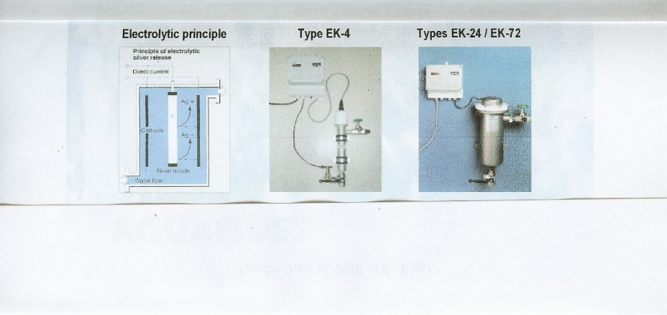
Silver Ion Generators

Slide 8
Government Regulations
Silver ion is approved for use in drinking water under EPA 40 CFR part 143 and FDA 21 CFR part 165 subpart B 165.110. In both CFR’s silver is considered a secondary contaminate, not a primary contaminate.
EPA and FDA limits on silver in drinking water are 0.1 ppm or 100 ppb.
The Katadyn silver ion generators are designed to impart a maximum of 0.05 ppm or 50 ppb based of flow rates and gallon per minute requirements.
EPA under 40 CFR part 180 subpart D 180.094 allows Silver ions resulting from the use of electrolytically-generated silver ions stabilized in citric acid as silver dihydrogen citrate as a food contact material for food-contact surfaces in public eating places, dairy-processing equipment, and food-processing equipment and utensils, but not to exceed 50 ppm of silver ion.

Slide 9





Who uses silver ion?

Slide 10
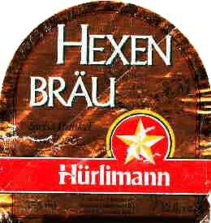





Slide 11
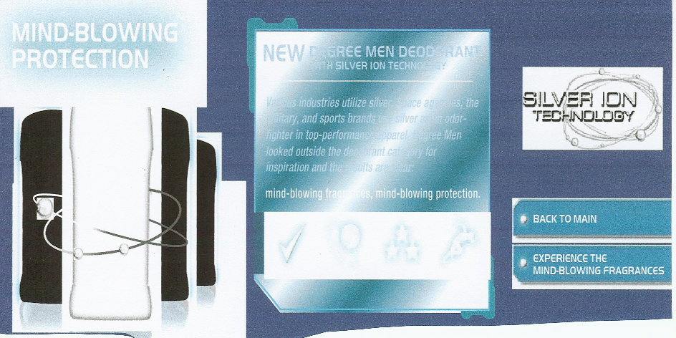

Slide 12
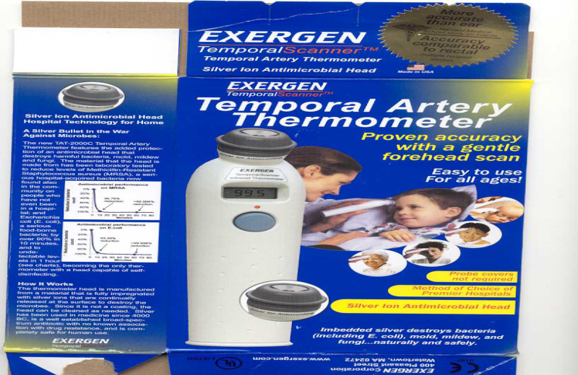

Slide 13
Silver Ion Uses in Europe
Silver ion has been used in Europe for up to 40 years in several industries.
Applications:
Drinking water Food industry
• Ships, platforms, civil defense, military • Process water, disinfection water, rinse water for butter, cheese, and pasta, etc.
Beverage industry Wine treatment
• Table-water, rinsing water, disinfection water • Elimination of wine defects due to sulphur
Main benefits :
• Treatment under mild conditions, non-toxic • Small amounts of treatment agent
• No change of natural taste • No toxic reaction byproducts
• Long conservation of water • No corrosive effect
• Residual effect even with extremes in temperature • Ease of operation and maintenance

Slide 14
Silver Ion vs Chlorine – Industry and Municipalities
Silver based water purification systems offer the most reliable and cost effective alternative to chlorine, a chemical that is increasingly coming under fire for the carcinogenic by products it leaves in water, according to David Eaton, secretary of The Institute of Water Ionization Technologies in the United Kingdom and technical director of Roseland Hydronics PLC.
Speaking at the annual meeting of The Gold & Silver Institutes in Laguna Niguel, CA. Eaton said progressively restrictive legislation is confronting the use of chemicals, especially chlorine, which for nearly a century has been the primary medium for water disinfection.
With increasing pollution, utilities are forced to put far more chlorine into the supply chain, Eaton explained. The chemical reaction that oxidizes impurities when chlorine is added, also forms carcinogenic byproducts. "Of course these same byproducts have been generated by chlorination for a long time but never in the quantities that are now being seen," he said.
Silver offers a healthy alternative. The metal has long been known for its biocidal properties, Eaton noted. The Ancient Phoenicians. who stored wine in silver urns to preserve it, provide one of the earliest recorded examples of the metal’s use for water purification.

Slide 15
Silver Ion vs Ozone and UV
Ozone is a great oxidizer and is effective on yeast, some molds, bacteria and has a half life of about 8 minutes. Requires lots of equipment and power to produce.
Due to the strongly oxidizing properties of ozone, it is a primary irritant, affecting especially the eyes and respiratory systems and can be hazardous at even low concentrations.
UV –C has been used in production of drinking water and waste water treatment
The effectiveness of UV depends on the light intensity, turbidity and distance from the light source. The further from the source the less effective. UV-C has been known to cause skin cancer.
Neither ozone or UV are as effective as silver ion on virus.
Silver Ion is more effective and less expensive to produce than ozone or UV.

Slide 16
Beverage Packaging Applications of Silver Ion
The silver ion generator is built based on your source water characteristics and flow rates desired. The unit is then manufactured base on those parameters.
The silver ion generator can be used at drinking water limits (0.05 ppm) for ‘finishing water’ or ‘cut down water’ in the brewing process. It can also be incorporated with municipal water for all the drinking fountains, coffee makers, ice machines, break room sinks, bath room sinks and toilets.
The silver ion generator can be adjusted to disinfection limits of 0.4 ppm and be used for conveyor lubrication spray, final CIP rinse of filler/capper/seamer, pasteurizer water, cooling tower water, process and clean-up water, final equipment rinse water, brewing tanks, aging tanks and all stainless steel piping. Virtually anywhere water and/or chemicals are used for cleaning operations. There is a significant savings in cleaning time and chemical costs.

Slide 17
Second Item-PurClean
Given the effectiveness of silver ion, it makes sense to manufacture a silver based cleaner that has all the advantages of silver ion, except with much quicker results.
This product is environmentally safe and extremely effective.
PurClean is a non-toxic, clear, odorless and biodegradable cleaner that does not contain phosphorus, phosphates, ammonia, chlorine compounds or other harmful chemicals.
PurClean can be applied without using face masks, rubber gloves or any special protection.
PurClean knocks down biofilm and scale in 10 minutes or less, depending on the degree of scaling. This product has been tested on bottled water coolers and POU coolers by several large bottled water companies with extremely effective results. Additionally, independent testing by a local laboratory have also confirmed effective results.
PurClean has been tested by a local chemical supply company that reported not only descaling, but also effective removal oil based compounds.
PurClean is silver dihydrogen citrate and can therefore be applied to any food contact surface.

Slide 18
PurClean Uses and Applications in Beverage Packaging
To be most effective, PurClean must remain wetted on any surface for 10 minutes.
For the Process- PurClean can be used in storage/aging tanks and piping, plus any equipment with internal components requiring cleaning.
For the Packaging Line- Can be used on conveyors with any type belting, rinsers, filler/capper/seamer, pasteurizers/coolers, labelers, packers, case conveyors, palletizers, etc.
An added benefit will be the plant drains.
For food service and janitorial- Can be used on all hard surfaces in kitchens, break rooms, bathrooms, tables, chairs, door knobs, toilet seats, sinks and handles, reception desk and furniture, laboratory surfaces, lab equipment, floors and drains.
For Warehouse- Can be used in any area requiring cleaning including driver lounges, trailers with off odors or visible organic contamination.
PurClean can be used in/on the entire plant where any cleaning and sanitation is paramount.

Slide 19
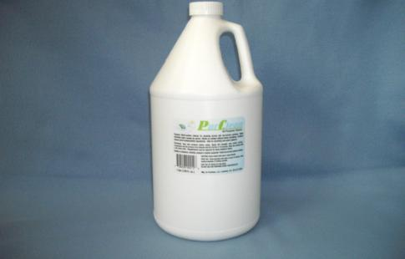
I would like to thank the Master Brewers Association- Rock Mountain Division for the opportunity to present silver ion technology and PurClean Cleaner. As indicated earlier, this is older technology, but definitely new to the US and the beverage industry. I hope this information has been helpful and thought provoking……….. Thank You

